Slide 1
Framework for a 3-Hour Proficiency Workshop

Slide 2
NOTE to Presenter:
Slides # 3 – 8 are notes on how to present your workshop.
These slides wouldn’t be included in your presentation

Slide 3
Location of Workshop Documents:
http://oflaslo.weebly.com/moving-your-state-from-performance-to-proficiency-the-ohio-model.html

Slide 4
Ideas For Moving Your State From Performance to Proficiency
OFLA and ODE work closely together so that there is a consistent message.
Vertical alignment in your building, district and state is a must.
We used our Ohio Teacher Evaluation System (OTES) to drive the instructional shift. We took the lead and gave input into how our world language teachers would be evaluated.
The ODE Model Curriculum and the OFLA Weebly provide current and effective resources for our teachers: IPA samples, authentic resources, rubrics, Can-Do checklists, instructional and assessment tools, websites for language learners, and other resources.

Slide 5
Ideas For Organizing Workshops
We use the OFLA listserv and ODE announcements to organize workshops, spread the message, share ideas and answer questions.
We created a cohort of teachers that were trained to lead workshops on proficiency, modes of communication, and performance-based assessments.
We led (and continue to lead) workshops around the state to get teachers on board, including at the OFLA state conference.
ODE and OFLA continue to offer free or low-cost professional development around the state, for teachers who want to learn even more!

Slide 6
Additional Suggestions
For districts that only have 1 or 2 world language teachers, or are isolated from collaboration with other colleagues:
We encourage these teachers to form Professional Learning Networks for support and collaboration.
These teachers collaborate via Facebook Groups; Google Hangouts or Google Docs; email groups; periodic meetings for face-to-face collaboration, discussions, or guest speakers.

Slide 7
How Do I Run My Workshop?
The Central States workshop was similar to how we run our Ohio workshops.
We incorporate continuous teacher input, sharing and discussion during the workshop.
This allows teachers to see that they are already doing a lot of proficiency-based instruction and assessment in their classrooms.
We provide concrete examples for everything we talk about.
We share numerous resources that are already available online, to show teachers that they don’t have to start from scratch.
We encourage teachers to incorporate this at a pace that works for them. It may take several years to implement everything that they want to implement and to develop a repertoire of resources.

Slide 8
NOTE to Presenter:
The rest of this Power Point is the framework for your workshop presentation!

Slide 9
Integrated Performance-Based Assessments
Moving Your State From Performance to Proficiency
Novice
Intermediate
Advanced

Slide 10
Your Contact Information

Slide 11
Agenda
Online resources for today’s workshop
(Your state)’s World language standards
Performance vs Proficiency
ACTFL proficiency levels
Using Can-Do statements to guide instruction
IPAs, authentic cultural resources and task creation
Rubrics
Novice
Intermediate
Advanced

Slide 12
Goals of this workshop
Summarize our state standards and the difference between performance and proficiency.
Clarify the What, the Why, the When and the How of performance-based instruction and assessment.
Specify available resources for instruction and assessment, as well as tools to help educators understand the ACTFL proficiency levels.
Learn how to gradually integrate these tools into what teachers are already doing so that teachers don’t have to re-invent the wheel.

Slide 13
Helpful Websites
(add web links that you feel will be helpful to teachers in your state)
Ohio’s World Language Model Curriculum: http://education.ohio.gov/ (search box: World Language Model Curriculum)
Ohio Foreign Language Association weebly: http://oflaslo.weebly.com/
ACTFL http://www.actfl.org/

Slide 14
(Your state)’s World Language Standards
(Prior Knowledge: Ask what they already know about your state standards)

Slide 15
(Your state)’s World Language Standards
Provide an outline or summary of your state’s World Language standards

Slide 16
Three Modes of Communication:
a) Interpretive: reading, listening, viewing
Comprehension of a video, audio or text through reading, listening to, or viewing the source.
b) Interpersonal: speaking/listening; writing/reading Interaction with others via oral, written or signed conversations. Negotiation of meaning, exchange of opinions or information.
c) Presentational: writing, speaking, signing
Delivering information via speaking, writing or signing,
in prepared or spontaneous presentations.

Slide 17
90% Target Language
Group Prior Knowledge: How do you use TL in your classroom? What are your challenges?, etc.

Slide 18
Use of the Target Language
Provide or Brainstorm strategies for staying in the target language
See ODE Model Curriculum “Instructional Strategies” for TL strategies
http://education.ohio.gov/Topics/Ohio-s-New-Learning-Standards/Foreign-Language/World-Languages-Model-Curriculum/World-Languages-Model-Curriculum-Framework/Instructional-Strategies

Slide 19
Performance vs Proficiency
Group Prior Knowledge: what do they think is the difference?
What do they already know about this, etc?

Slide 20
Performance vs. Proficiency

Slide 21
Performance vs. Proficiency
Performance levels may be higher than Proficiency levels:
Example: A student may be at Intermediate Low on a unit assessment that they just practiced. (Performance)
In a spontaneous situation, the same student may now only be at a Novice High. (Proficiency)

Slide 22
Importance of Communicative Proficiency
Provide notes or group brainstorm why it’s important for students to be proficient in the language, vs just knowing grammar or vocab.

Slide 23
ACTFL Proficiency Levels
Group Prior Knowledge: ask what they already know about ACTFL and proficiency levels, etc.

Slide 24
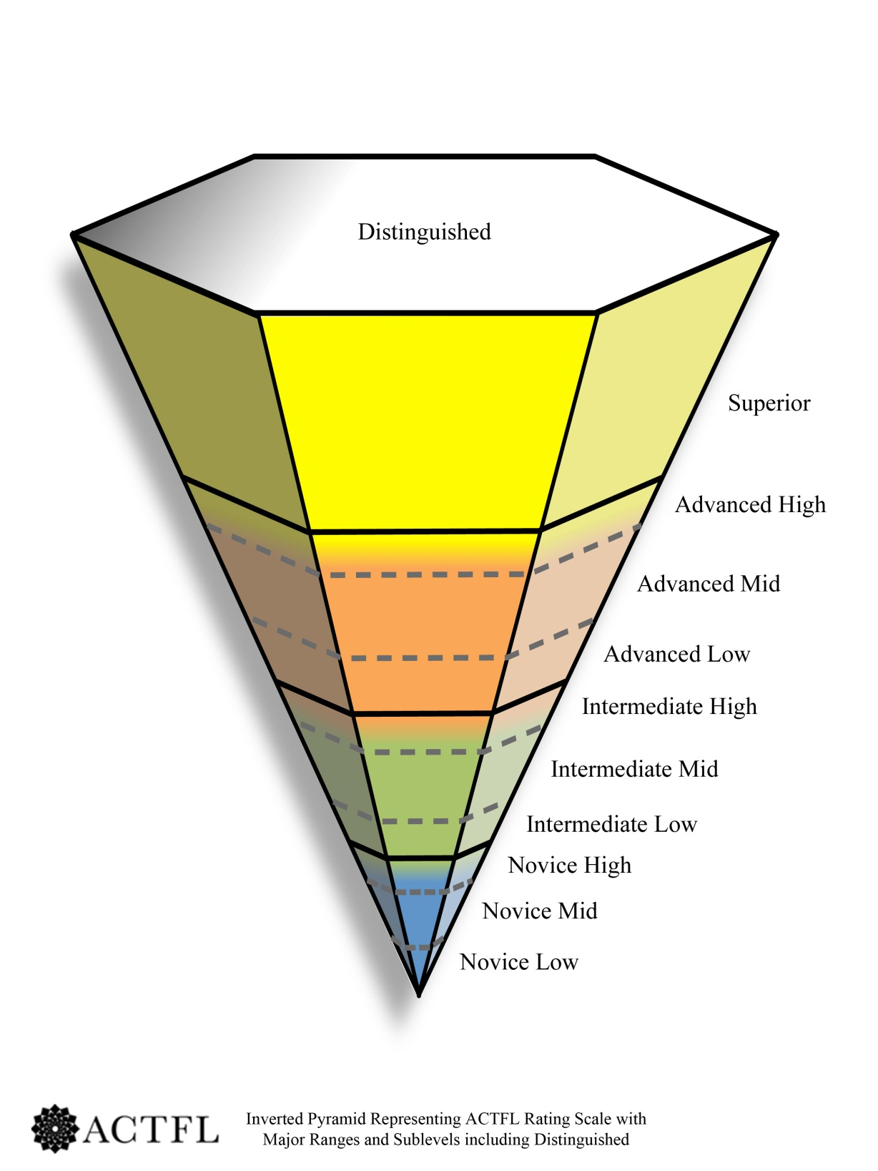
ACTFL Proficiency Levels
Notes:
Stress how Novice Low is the key. If the Level 1 teacher isn’t doing it, it will affect the students and teachers all they way up the pyramid.

Slide 25
The ACTFL Proficiency Guidelines
The ACTFL Proficiency Guidelines and Levels: http://actflproficiencyguidelines2012.org/
refer to real-world, authentic situations in a spontaneous and non-rehearsed context.
evaluate sustained, functional language ability, regardless of where, when or how the language was acquired.
describe what individuals can do with language in terms of speaking, writing, listening, and reading.

Slide 26
The ACTFL Proficiency Guidelines
The ACTFL Proficiency Guidelines and Levels: http://actflproficiencyguidelines2012.org/
Print the ACTFL pyramid (8.5 x 11, or 11 x 17).
Download the proficiency guidelines, by skill and level.
View writing and speaking samples of each proficiency level, in many languages.

Slide 27
ACTFL Proficiency Levels Defined

Slide 30
NCSSFL-ACTFL Can-Do Statements
Group Prior Knowledge: ask what they already know about the Can-Do statements, do they use them, etc.

Slide 31
NCSSFL-ACTFL Can-Do Statements
The new 2013 Can-Do statements are aligned to the ACTFL Proficiency Levels, in student-friendly language.
They give concrete examples of what students should be able to do in reading, writing, listening, speaking, and interpersonal skills at each proficiency level.
The Can-Do statements are a good reference tool for teachers, parents and administrators, to help clarify what proficiency in a language looks like and to show the expectations for the class.

Slide 32
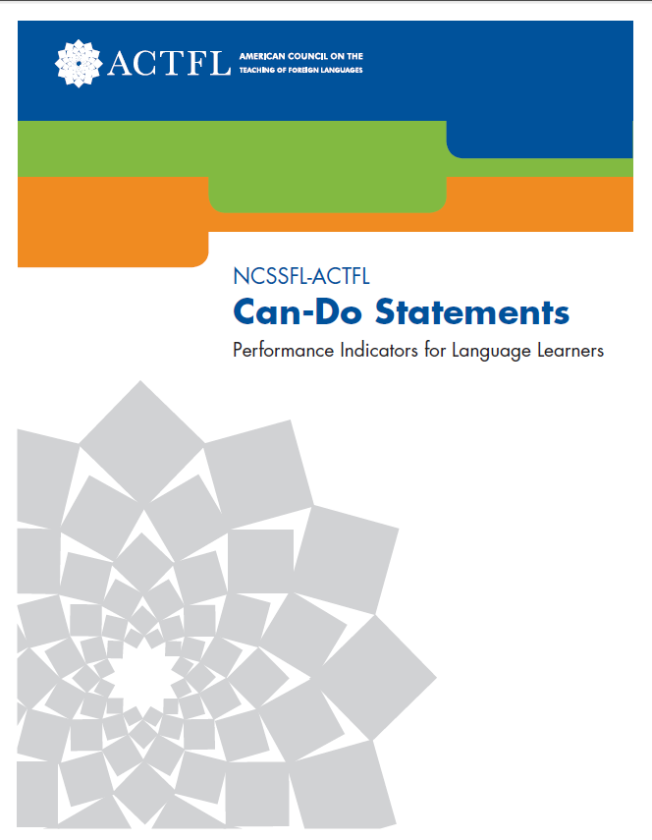
NCSSFL-ACTFL Can-Do Statements
The NCSSFL-ACTFL Can-Do checklists are available in the ODE Model Curriculum (under “Expectations for Learning”).
Can-Do statements are also
found on the ACTFL website
under “Publications”.

Slide 33
Backward Design
Group Prior Knowledge: ask what they already know about Backward Design, why is it important, etc.

Slide 34
Designing an IPA, Unit or Course
Backward Design (Wiggins and McTighe):
1. Identify desired results:
Performance target, communicative and cultural goals
2. Determine acceptable evidence:
Performance-based assessment
3. Plan learning experiences and instruction: Instructional activities, authentic resources and content

Slide 35
IPAs – Integrated Performance Assessments
Group Prior Knowledge: ask what they already know about IPAs, do they use performance-based assessments, etc.

Slide 36
What is an IPA?
An IPA is a multi-task
assessment framework
designed by ACTFL.

Slide 37
Integrated Tasks Within A Common Theme

Slide 38
Three Parts of an IPA
Explain the 3 parts of an IPA.
For help: The ODE Model Curriculum has detailed information about IPAs
http://education.ohio.gov/Topics/Ohio-s-New-Learning-Standards/Foreign-Language/World-Languages-Model-Curriculum/World-Languages-Model-Curriculum-Framework/Instructional-Strategies#strategies2

Slide 39
Where Can I Find Sample IPAs? (include other links where they can find IPAs)
ODE World Languages Model Curriculum
→Instructional Strategies → Unit Samples
OFLA Weebly site: oflaslo.weebly.com :
Under second tab at the top: “IPA Center”
OFLA Technology IPAs:
→ Livebinders.com → OFLA IPA Tech Integration

Slide 40
Designing an IPA and Unit
Provide a sample IPA template for teachers to refer to as you go over the components of designing an IPA.

Slide 41
Why use an IPA?
Provide or brainstorm ideas as to why an IPA is beneficial

Slide 42
What Type of Tasks are in an IPA?
Provide or brainstorm ideas as to how teachers can create IPA tasks that involve higher-level thinking skills.
Provide or brainstorm how to create open-ended tasks with “Stretch” so all students can succeed.
Provide or brainstorm tasks that are real-world and appropriate for different levels of learners.

Slide 43
Interpretive Mode of Communication
Group Prior Knowledge: ask what students should be able to do in interpretive tasks, in reading, writing, etc.

Slide 44
Interpretive Communication

Slide 45
Developing Interpretive Tasks Using the ACTFL template - Appendix D
Provide a copy, or link to, the ACTFL Appendix D for creating interpretive tasks that encourage higher level thinking skills.
Go over the components of Appendix D together, and which parts might be used with which level of students.
A pdf of Appendix D is found in Ohio’s Model Curriculum:
http://education.ohio.gov/Topics/Ohio-s-New-Learning-Standards/Foreign-Language/World-Languages-Model-Curriculum/World-Languages-Model-Curriculum-Framework/Instructional-Strategies/Assessment-Guidance-and-Sample-Rubrics

Slide 46
ACTFL Rubric for scoring Interpretive Tasks - Appendix F
Provide a copy, or link to, the ACTFL Appendix F for creating interpretive tasks that encourage higher level thinking skills.
Explain how Appendix F aligns to Appendix D, for any level student.
A PDF of Appendix F is found in Ohio’s Model Curriculum:
http://education.ohio.gov/Topics/Ohio-s-New-Learning-Standards/Foreign-Language/World-Languages-Model-Curriculum/World-Languages-Model-Curriculum-Framework/Instructional-Strategies/Assessment-Guidance-and-Sample-Rubrics

Slide 47
Sample Interpretive Activities
Provide your participants with actual Interpretive Reading and Listening activities that you have done with your students in your classroom.
Ask participants to share ideas for activities that they have done.

Slide 48
Authentic Cultural Resources
Group Prior Knowledge: ask what makes a resource authentic, what are benefits of using authentic resources, etc

Slide 49
What is “Culture” ?
Products (the What):
monuments, laws, music, etc.
Practices (the How):
eating or shopping habits, use of space, etc.
Perspectives (the Why):
values, attitudes, beliefs, etc.

Slide 50
How Can I Embed Culture Into My Lessons?
Provide or link to the NCSSFL intercultural Can-Do statements:
http://education.ohio.gov/Topics/Ohio-s-New-Learning-Standards/Foreign-Language/World-Languages-Model-Curriculum/World-Languages-Model-Curriculum-Framework/Expectations-for-Learning
Look at the culture Can-Dos together, discuss how teachers and students can use them, etc.
Brainstorm ways to embed culture into lessons, instead of making it a separate piece of the curriculum

Slide 51
What is an Authentic Resource?
An audio, video, or text made by native speakers for native speakers.
It gives a distinct native perspective of the target culture and its people by providing a real-life experience of the products and practices of that culture.
An authentic resource has not been modified or simplified for language learners.*
*Many textbook resources have been modified or simplified.

Slide 52
What Type of Authentic Resource Should I Use?
Discuss / brainstorm appropriate types of authentic resources for different levels of students.
Discuss what makes an effective or useful authentic resource.

Slide 53
Where Can I Find Authentic Resources? (Include other links that you use)
Ohio Department of Education Model Curriculum for World Languages: Instructional and Authentic Resources
FLTeach: http://web.cortland.edu/flteach/flteach-res.html
Youtube. Google images. Google (.fr / .es/ .de / etc.)
GROUP SHARING of websites they use for authentic resources

Slide 54
Interpersonal Mode of Communication
Group Prior Knowledge: ask what students should be able to do in interpersonal conversations, oral or written, share ideas, etc.

Slide 55
Interpersonal Communication

Slide 56
Sample Interpersonal Activities
Provide your participants with actual Interpersonal activities that you have done with your students in your classroom.
Ask participants to share ideas for activities that they have done.

Slide 57
Logistics for Assessing Interpersonal Speaking
How do I keep the other students busy
while I’m assessing?
Group sharing of strategies for organizing and assessing interpersonal activities for an IPA.

Slide 58
Presentational Mode of Communication
Group Prior Knowledge: ask what students should be able to do in oral or written speech, share ideas, etc.

Slide 59
Presentational Communication

Slide 60
Sample Presentational Activities
Provide your participants with actual Presentational speaking and writing activities that you have done with your students in your classroom.
Ask participants to share ideas for activities that they have done.

Slide 61
Benefits of IPAs
Discuss as a group the benefits of IPAs or other Performance-based assessments, as opposed to multiple choice or vocab and grammar tests.

Slide 62
IPA sample
Provide participants with a sample of an IPA that you created and used with your students in your classroom.
Talk about how you developed it, share samples of student work from the IPA, etc.
Brainstorm how this IPA could be “stretched” to be used with other levels of learners (higher or lower levels)

Slide 63
Whole Group Creation of an IPA
Provide participants with an authentic resource in another language (e.g., weather map, school schedule, clothing catalog, etc.)
As a group, brainstorm the tasks that you could develop, to make an IPA from this resource.
Stress how creating an IPA can be collaborative despite different languages. Everyone finds a similar resource in their target language, then works together to make up the IPA tasks.

Slide 64
Small group - IPA creation
If you have time, give participants a blank IPA template and break them into small groups.
Have them create the tasks for an end-of-unit IPA based on a theme or topic that they cover in their curriculum.
Share the IPAs with the whole group.

Slide 65
Rubrics
Group Prior Knowledge: ask if they already use rubrics, what are the benefits, challenges, etc.

Slide 66
Rubrics
Define for participants the components of an analytic (performance) rubric and a holistic (proficiency) rubric.
Share samples of each type of rubric.
For help, Ohio’s model curriculum has information about rubrics and sample rubrics:
http://education.ohio.gov/Topics/Ohio-s-New-Learning-Standards/Foreign-Language/World-Languages-Model-Curriculum/World-Languages-Model-Curriculum-Framework/Instructional-Strategies

Slide 67
References
Adair, Glisan, Troyan. Implementing Integrated Performance Assessments. American Council on the Teaching of Foreign Languages, 2013
Sandrock, Paul. The Keys to Assessing Language Performance: A Teacher's Manual for Measuring Student Progress. American Council on the Teaching of Foreign Languages, 2010
American Council on the Teaching of Foreign Languages, 2015. www.actfl.org
Battelle for Kids, 2015. FIP Your School Ohio. http://portal.battelleforkids.org/FIPOhio
Kentucky Department of Education, 2015. http://education.ky.gov/curriculum/wlang
National Council of State Supervisors for Languages, 2015. www.ncssfl.org
OFLA Weebly, 2015. http://oflaslo.weebly.com
Ohio Department of Education, 2015: http://education.ohio.gov
Ohio Foreign Language Association, 2015. http://www.ofla-online.org/

